Slide 1
Secure Data Hiding in Image Using Steganography
CAPSTONE PROJECT
Student Name: Suruchi Sachin Patil
College Name & Department: Walchand Institute of Technology (WIT)
B.Tech in Computer Science and Engineering (CSE)

Slide 2
OUTLINE
Problem Statement
Technology used
Wow factor
End users
Result
Conclusion
Git-hub Link
Future scope

Slide 3
Problem Statement
Secure Data Transmission: Traditional data transmission methods are vulnerable to interception; steganography provides a way to hide messages within images to enhance security.
Data Hiding in Images: Steganography enables embedding messages within images, making the data less detectable than encryption alone.
Minimal Image Distortion: The hidden message should be embedded in a way that preserves the image quality while ensuring secure retrieval.

Slide 4
Technology used
Programming Language:
Python – Used for implementing the steganography logic and GUI.
Libraries & Frameworks:
OpenCV – For image processing (reading, modifying, and saving images).
Tkinter – For creating the graphical user interface (GUI).
TkinterDnD2 – For enabling drag-and-drop functionality for image selection.
Platform:
Windows – The application is developed and tested on a Windows environment using VS Code as the development tool.

Slide 5
Wow factors
Unique Features:
Dual-Layer Security:
Unlike basic steganography, this project integrates a password-based encryption mechanism, ensuring that only authorized users can retrieve hidden messages.
Minimal Image Distortion:
The encoding method is optimized to embed data while preserving the original image quality, making detection nearly impossible.
Drag & Drop Functionality:
Enhances user experience by allowing easy image selection through drag-and-drop, making the process faster and more intuitive.

Slide 6
End users
Journalists & Activists: Individuals who need to securely transmit sensitive information without detection.
Government & Military Personnel: Used for covert communication to prevent data leaks and espionage.
Cybersecurity Enthusiasts & Researchers: People exploring data hiding techniques for encryption, digital forensics, and secure data transmission.

Slide 7
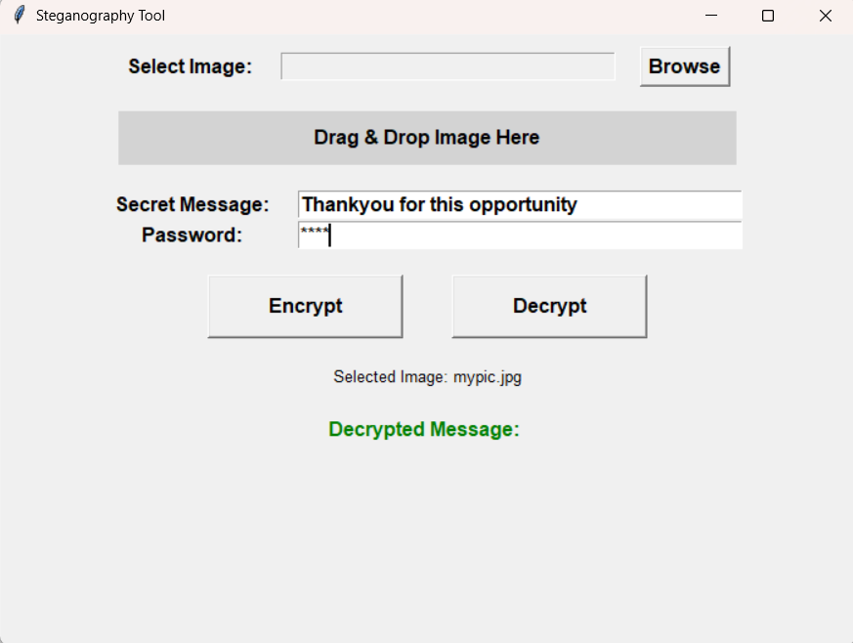
Results
1. Screenshot: Upload an image and encode a message with a secure password.

Slide 8
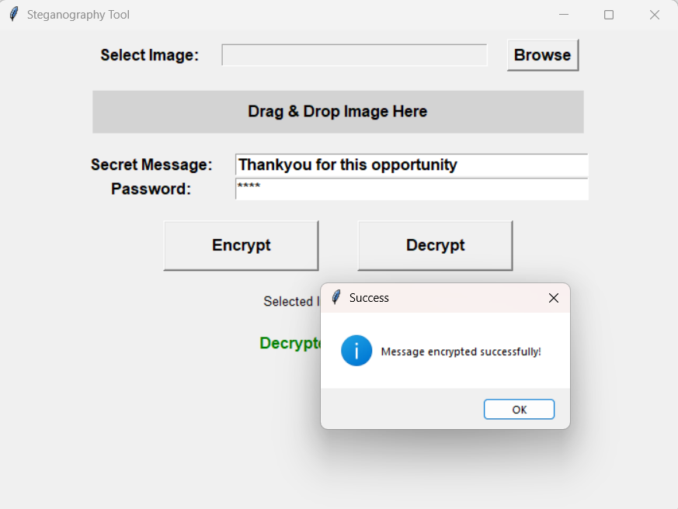
Results
2. Screenshot: Successfully message got encrypted.

Slide 9
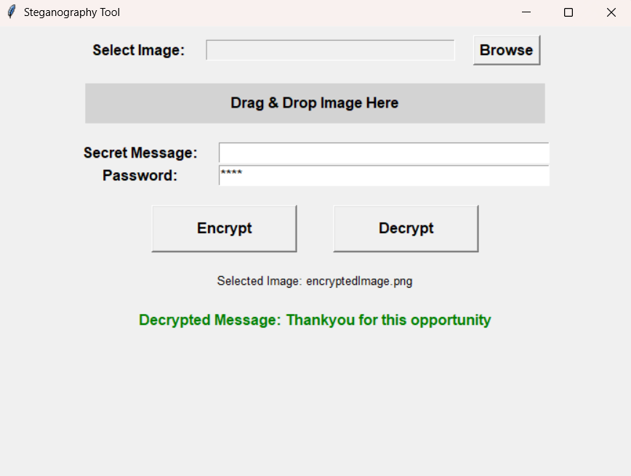
Results
3. Screenshot: Decode the hidden message using the correct passcode.

Slide 10
Conclusion
Secure Communication: The project enables covert message transmission by embedding data within images.
Password Protection: Adds an extra layer of security to ensure only authorized users can access hidden messages.
Efficient & Undetectable: Maintains image quality while concealing data, making detection extremely difficult.

Slide 11
GitHub Link
Repository: https://github.com/Suruchisp/steganography-project
ReadMe File: https://github.com/Suruchisp/steganography-project/blob/main/README.md

Slide 12
Future scope
Advanced Encryption Techniques – Integrate stronger encryption algorithms for enhanced security.
Support for Multiple File Types – Extend steganography to hide messages in audio, video, and PDFs.
Mobile & Web Integration – Develop a cross-platform application for Android, iOS, and web usage.
AI-Based Detection Prevention – Implement AI techniques to make hidden messages even more undetectable.

Slide 13
THANK YOU

